Slide 1
Smart Feed Reader
Avilay Parekh
PM, Windows Azure

Slide 2
Introduction
Snapdragon feed reader
Website up and running
http://avilay.info
Test drive it..

Slide 3
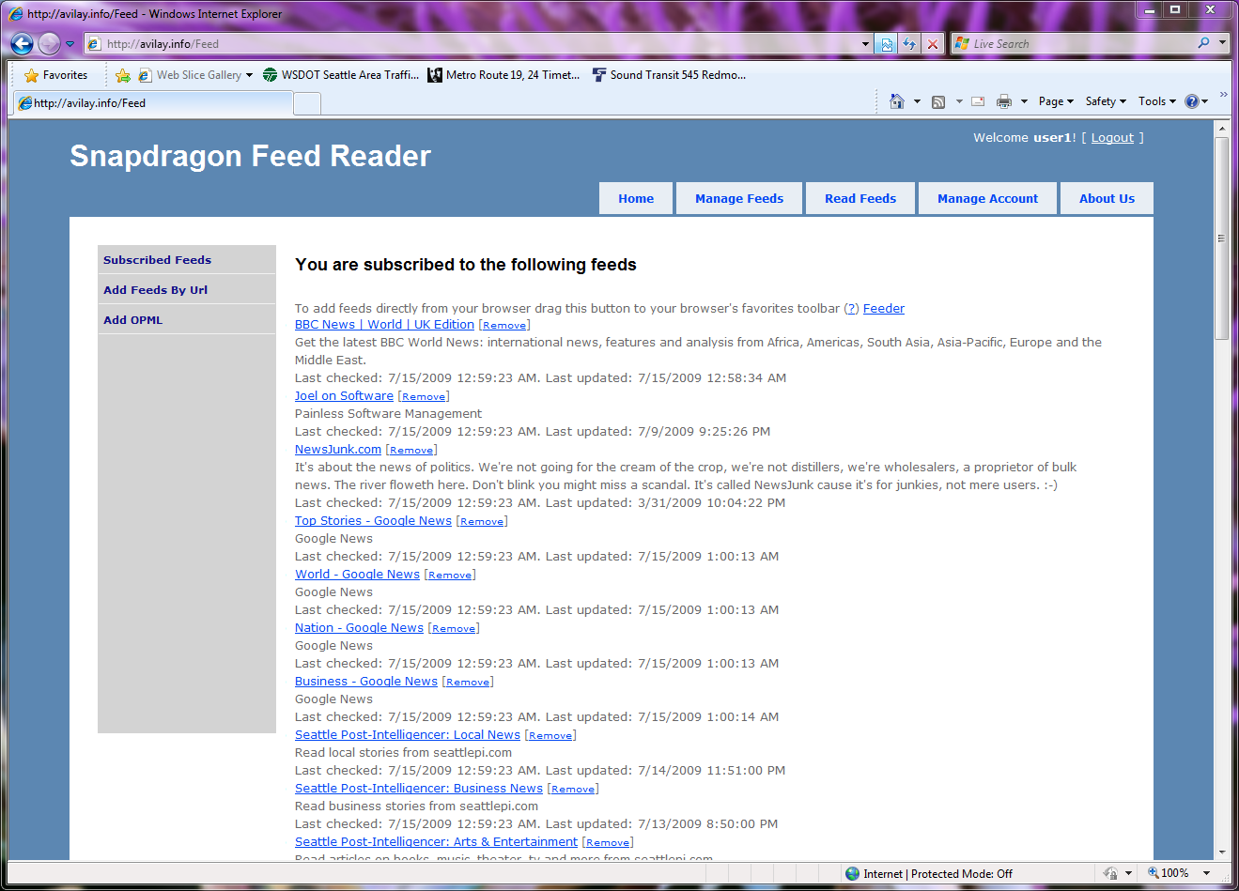
How many people subscribe to feeds via some reader (IE, Outlook, G, etc)?

Slide 4
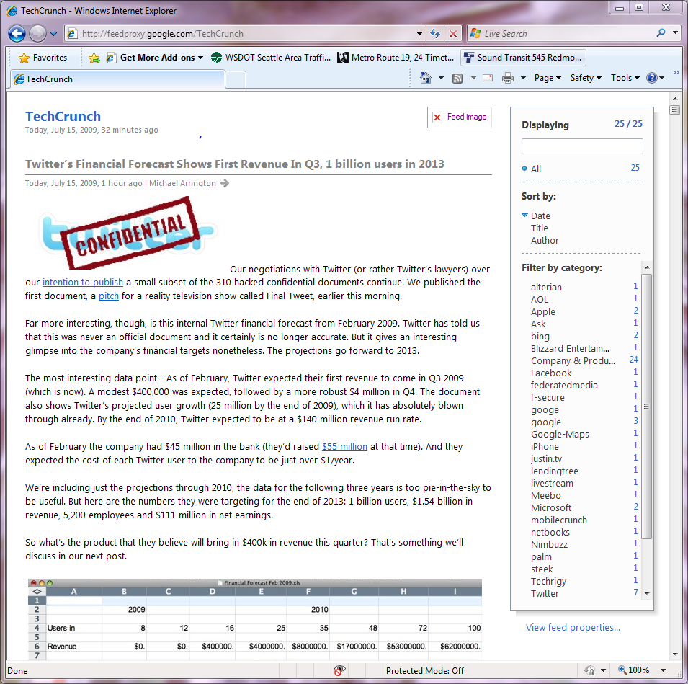
“Normal” way of reading feeds

Slide 5
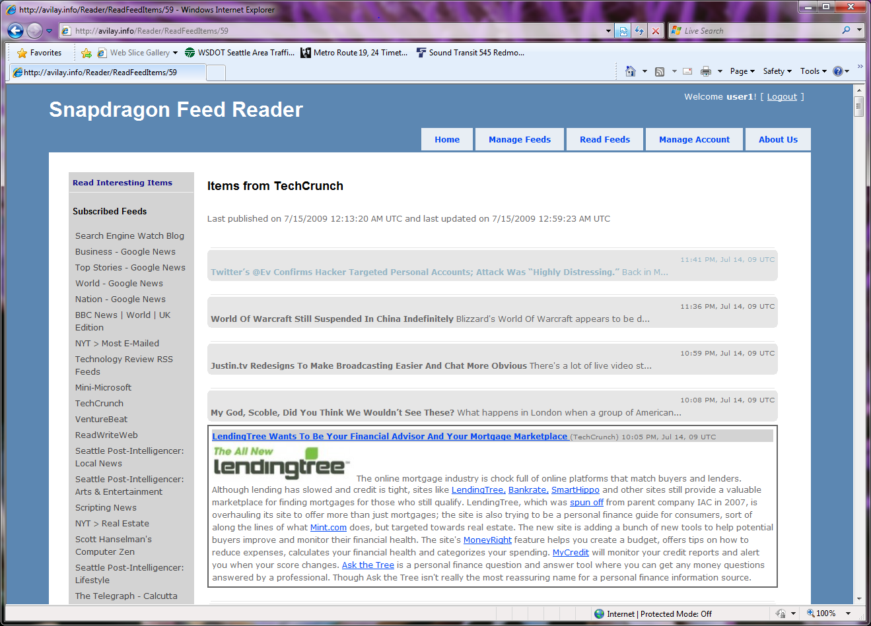
“Normal” way of reading feeds

Slide 6
Introduction
Information overload
Avg of 10 new items / feed / day
10 feeds => 100 new items / day
Who can keep up with this?

Slide 7
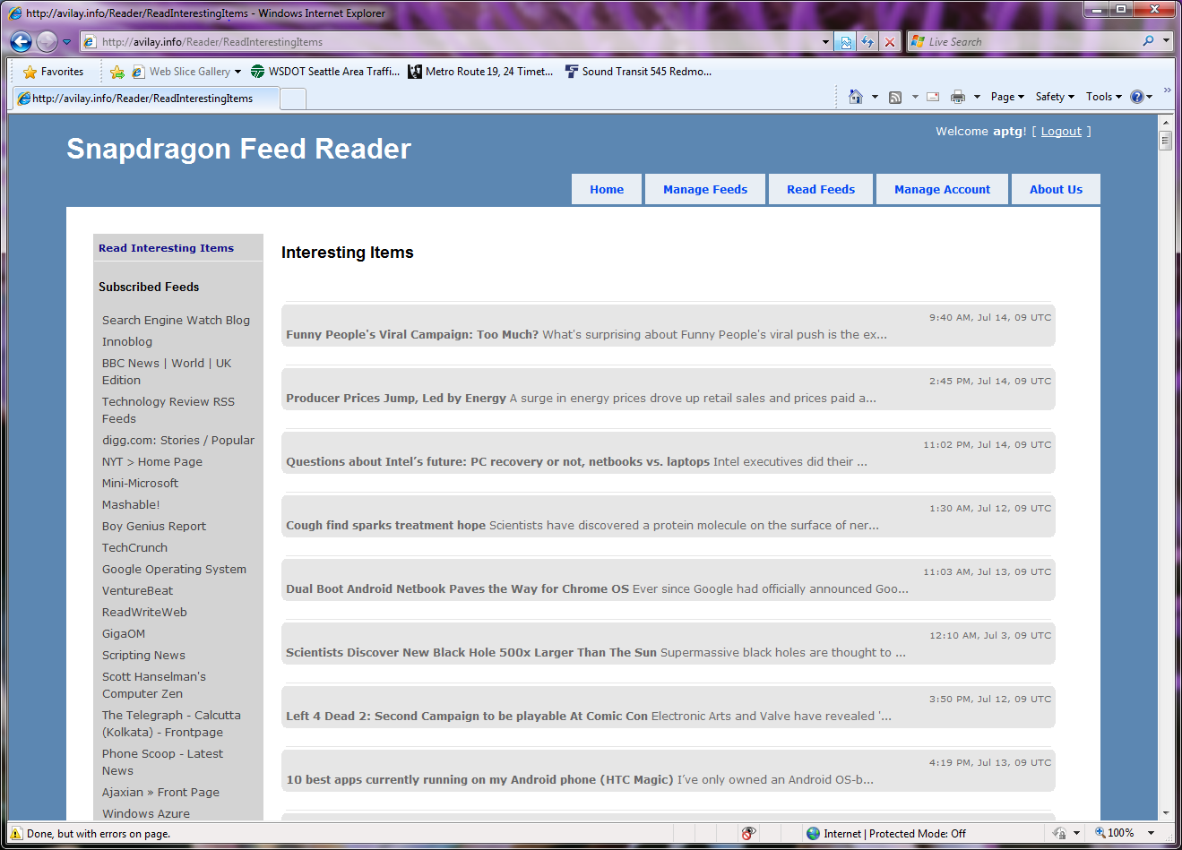
Cherry pick items that you might find interesting

Slide 8
How does this work?
No Interesting items out of the box
Need to use like a “normal” feed reader the first couple of times
Clicked item = Interesting item
System learns based on items clicked
Next time user logs in there are interesting items available

Slide 9
Help!
How do I communicate the value proposition of this service to the first-time visitor?
What would be a good tag-line?
What would be a good welcome blurb?
Do I need some kind of “quickstart” tutorials?
How bad is it if I require the first-time visitor to create an account to try out the service?

Slide 10
Help!
Need to re-think entire UX and UI
Any ideas on what a good Reader page would look like?
Is the single click a good enough indicator of user’s like?
What kind of search functionality does the site need?

Slide 11
More Features
Search functionality
FeedLists
Feed Discovery
Item sharing
Item tagging
Twitter integration
Facebook integration
…

